Slide 1

https://sahibulsaif.wordpress.com/wisdom/bismillah-nature/

Slide 2
Transforming er to relational model
CSC271 – DATABASE SYSTEMS

Slide 3
Previous Lecture Overview

Slide 4
Today’s Lecture
In this lecture, you will learn:
Transformation of
Normal Entities
Weak Entities
Binary Relationships

Slide 5
Transforming EER Diagrams into Relations
Mapping Regular Entities to Relations
Simple attributes: ER attributes map directly onto the relation
Composite attributes: Use only their simple, component attributes
Multivalued Attribute – Becomes a separate relation with a foreign key taken from the superior entity

Slide 6


Mapping a regular entity
CUSTOMER entity type with simple attributes
CUSTOMER relation

Slide 7


Mapping a composite attribute
CUSTOMER entity type with composite attribute
CUSTOMER relation with address detail

Slide 8

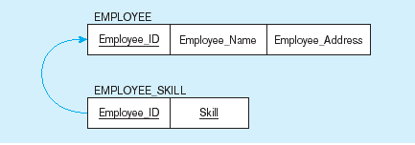
Mapping an entity with a multivalued attribute
Multivalued attribute becomes a separate relation with foreign key
One–to–many relationship between original entity and new relation

Slide 9
Transforming EER Diagrams into Relations (cont.)
Mapping Weak Entities
Becomes a separate relation with a foreign key taken from the superior entity
Primary key composed of:
Partial identifier of weak entity
Primary key of identifying relation (strong entity)

Slide 10
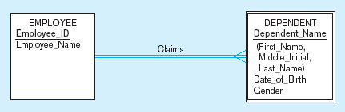
Example of mapping a weak entity
Weak entity DEPENDENT

Slide 11
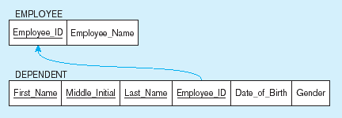
Example of mapping a weak entity (cont.)
Relations resulting from weak entity
Foreign key
Composite primary key

Slide 12
Transforming EER Diagrams into Relations (cont.)
Mapping Binary Relationships
One-to-One – Primary key on the mandatory side becomes a foreign key on the optional side
One-to-Many – Primary key on the one side becomes a foreign key on the many side
Many-to-Many – Create a new relation with the primary keys of the two entities as its primary key

Slide 13
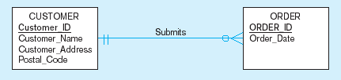
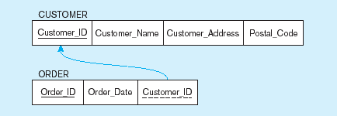
Example of mapping a 1:M relationship
Relationship between customers and orders
Note the mandatory one
Mapping the relationship
Foreign key

Slide 14
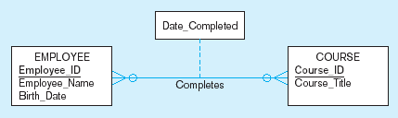
Example of mapping an M:N relationship
Completes relationship (M:N)
The Completes relationship will need to become a separate relation

Slide 15
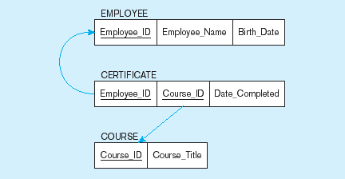
Example of mapping an M:N relationship (cont.)
Three resulting relations
Composite primary key
Foreign key
New intersection relation
Foreign key

Slide 16
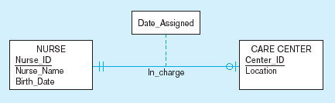
Example of mapping a binary 1:1 relationship
In_charge relationship (1:1)
Often in 1:1 relationships, one direction is optional.

Slide 17
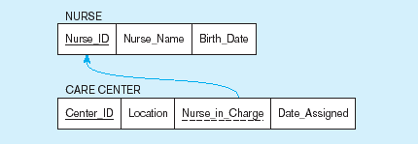
Example of mapping a binary 1:1 relationship (cont.)
Resulting relations
Foreign key goes in the relation on the optional side,
Matching the primary key on the mandatory side

Slide 18

http://www.thomasformo.com/category/qa/

